Slide 1

Event Processing Course
Engineering and implementation considerations (related to chapter 10)

Slide 2
Lecture outline
Non functional properties
Performance objectives
Optimizations

Slide 3

Non functional properties - scalability
Scalability is the capability of a system to adapt readily to a greater or lesser intensity of use, volume,
or demand while still meeting its business objectives.
  scalability in the volume of processed events
  Scalability in the quantity of agents
  Scalability in the quantity of producers
  scalability in the quantity of consumers
  scalability in the quantity of context partitions
  Scalability in context state size
  Scalability in the complexity of computation
  scalability in the processor environment

Slide 4

Non functional requirements - availability
Availability is the percentage of the time in which a certain system
is perceived as functioning by its users.
Recoverability is the ability to restore the state to
its exact value
before a failure occurred.

Slide 5
Non functional requirements - security
Ensuring only authorized parties are allowed to be event producers of event consumers
Ensuring that incoming events are filtered so that authorized producers cannot introduce invalid events, or events that they are not entitled to publish
Ensuring that consumers only receive information to which they are entitled. In some cases a consumer might be entitled to see some of the attributes of an event but not others.
Ensuring that unauthorized parties cannot add new EPAs to the system, or make modifications to the EPN itself (in systems where dynamic EPN modification is supported)
Keeping auditable logs of events received and processed, or other activities performed by the system.
Ensuring that all databases and data communications links used by the system are secure.

Slide 6
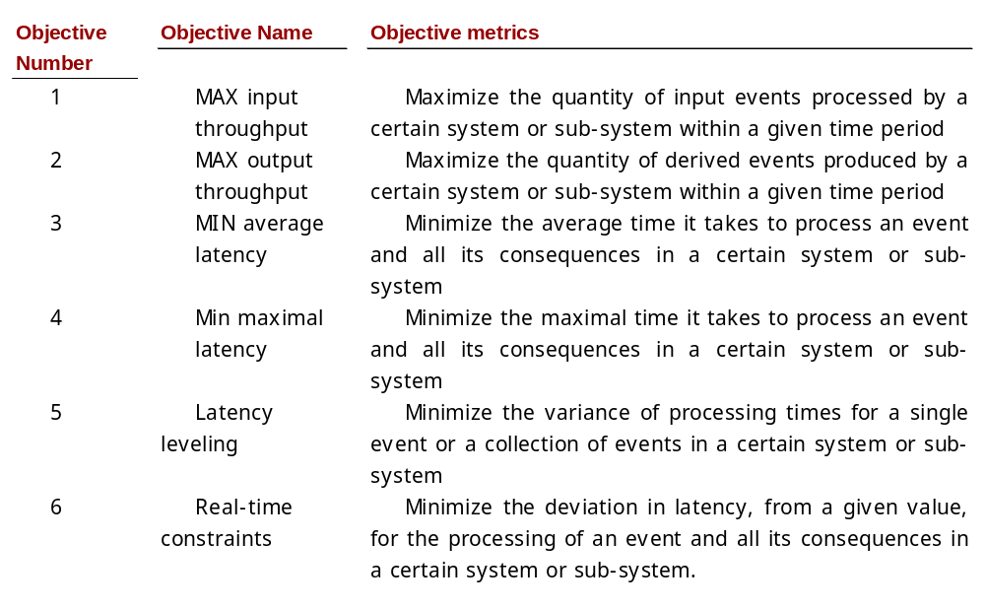
Performance objectives

Slide 7
Optimizations
Optimizations related to EPA assignment: partition, parallelism, distribution and load shedding.
Optimizations related to the coding of specific EPAs: code optimization, state management.
Optimization related to the execution process: scheduling, and routing optimizations.

Slide 8
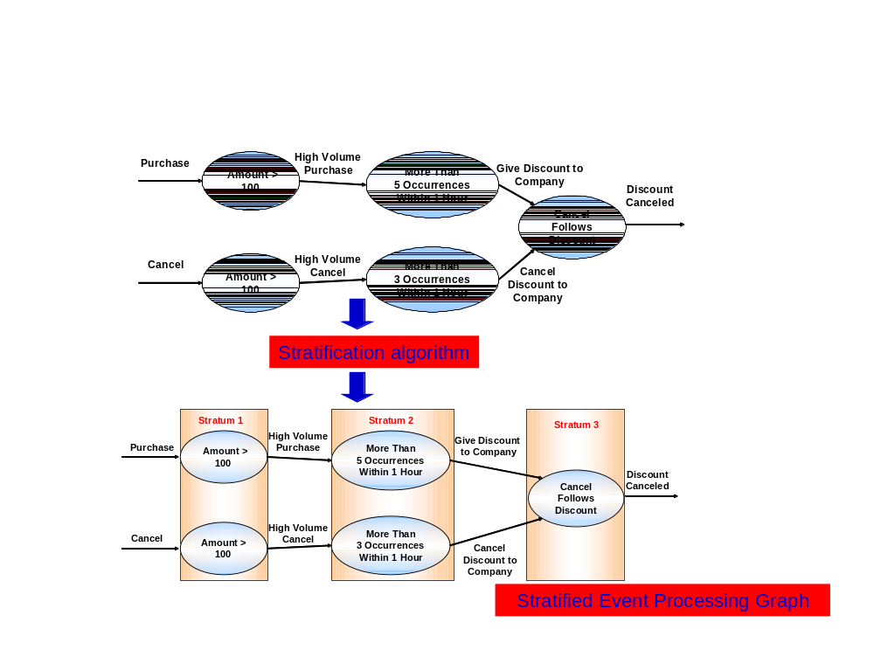
EPA assignment optimizations
Partitioning of EPA Instances to run time artifacts

Slide 9
More EPA assignment optimizations
Parallel processing
Distributed processing
Load shedding

Slide 10
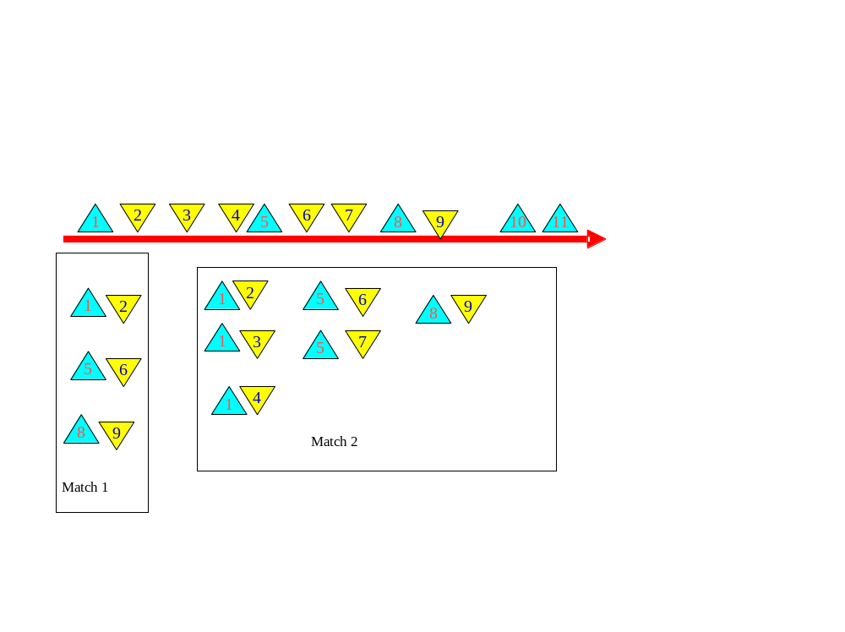
EPA code optimizations - optimized code generation

Slide 11
EPA code optimizations – state management
Using persistent states. This resolve space scalability issues and recoverability, however, it may harm performance goals.
Using in-memory databases that provide caching capabilities, while guaranteeing recoverability. This is a way to balance between the two sides of the trade-off, with various tuning possibilities that relate to different assumptions about MTBF (mean time between failures) an MTTR (mean time to repair), in this case time for recovery.
Using grid memory instead of persistence: The idea here is to replicate the state in memory held on multiple machines, so as to get recoverability without having to use disk-based persistence. This solution has an overhead of network traffic, and the complexity of synchronization among the different replicas.
Using a mixture of approaches: Use persistent storage for states that have space scalability issues, and in-memory for others. You can also allow different levels of recoverability for different EPAs.

Slide 12
Execution optimizations
Scheduling
Routing

Slide 13
Summary
In the lecture we discussed:
Non functional properties
Performance indicators
Optimizations

